Slide 1

MIST Smart Voting System(MSVS)
Group-02
Fahmida Yasmin Rifat 201714022
Rezwan-A-Rownok 201714035
Shahriar Rahman Khan 201714055
Sharmila Rahman Prithula 201714057
Zakaria Rahman 201714117

Slide 2
Project Idea
According to the current system MIST central issues are handled through manual paper ballot or raising hand technique, where ‘fake vote’ or ‘influenced voting’ have become very common. Thus corruption is occurring.
Also, their need to be a gathering of students or voters for deciding any central issue, as it is always not possible for all the voters to vote physically.
It uses a lot of time where time is really a concerning issue for the students.
Still, if we consider all the odds for the voters, we aren’t hundred percent sure that our votes are counted validly and the published result is accurate.

Slide 3
Objectives
A digital solution of the old analog voting system using Android and IOS app.
Saving time and cost for conducting any voting event.
Participating and giving votes from anywhere and anytime.
Making voting events transparent and secured.
Publishing Voting results in less time.

Slide 4
Features
Barcode scanning for authentication.
Create vote events, add candidates, choose candidates and voters, publish result, handle the history of the events.
Candidate’s profile view during the voting events, results view after the voting events.
Vote can be given to an event only once as it needs fingerprint to cast a vote and barcode information to authenticate the voter.
Vote can also be given using OTP, that is sent via email.

Slide 5
Project plan
Milestones:
Milestone number | Title | Forecast date
1 | Project Topic Selection | 25-jul-2019
2 | Database Design Completion | 20-feb-2020
3 | Integration of Sensors | 13-Mar-2020
4 | Overall design Completion | 2-apr-2020
5 | Overall Testing Completion | 1-Jan-2021
6 | Final Project Showcasing | 21-Jan-2021

Slide 6
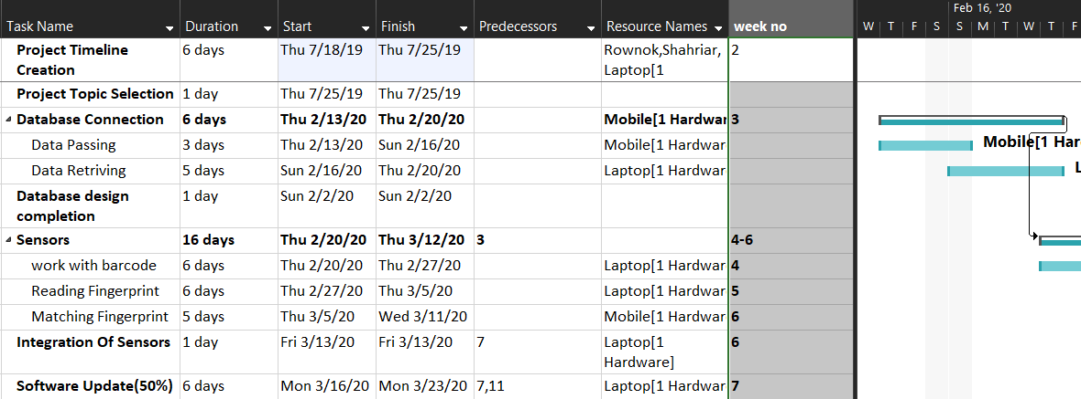
Project plan(cont.)

Slide 7
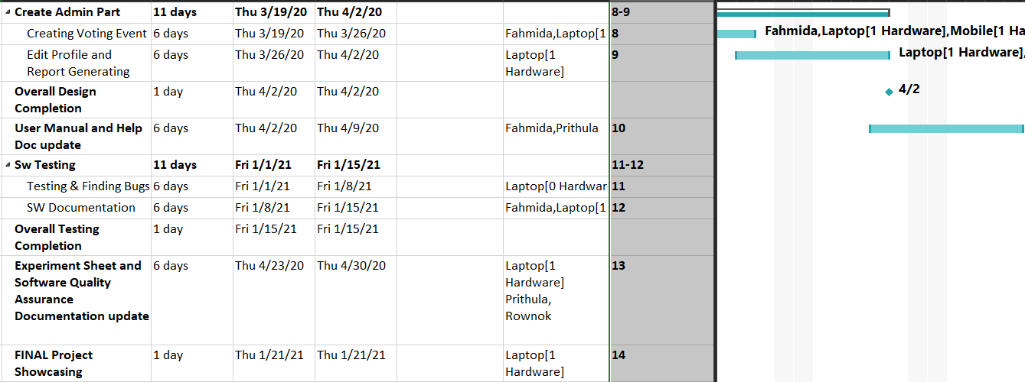
Project plan(cont.)

Slide 8







Conceptual Diagram
Gives authentic information to register as a voter
Creates voting events, adds candidates, accepts new voter request & updates voter profile
Casts vote using mobile fingerprint and OTP
Application Interface
Admin
System
Voter
Publish voting event results or history after the event ends
Voting event & candidate information
Server
Gives authentic information to become a candidate
Gets acceptance from the admin and becomes a candidate
Candidate

Slide 9









System Architecture
Fingerprint Sensor
Barcode Scanner
Mobile Device
Android Library
Zbar/Zxing
Admin Database
Voter Database
Database
Processed Data of Barcode Scanner
Processed Data of Fingerprint Sensor
Admin Panel
User Panel

Slide 10
Functional Requirements
The system uses the barcode of the id card of the students to sign up and sign in.
Admin can create vote events, allow the students to become a candidate, choose candidates and voters, publish result, handle the history of the events.
Valid voters can see candidate’s profile, view results after the voting events.
One can give vote to an event only once as it needs fingerprint to cast a vote.
Those who don’t have fingerprint sensor, can also give vote using confirmation code that is sent via email.
One can edit his/her profile.

Slide 11
Non-Functional Requirements
If the id card is not clean enough then the barcode scanner may not work properly.
If the fingerprint sensor is not clean enough then it may not identify the user’s fingerprint.
If there is any internet issue then the app will not work.
If someone steals voter’s id card, then he/she will be able to sign in as that voter.
Admin has to be careful about publishing results, he should never publish the results before the event being finished.

Slide 12
Software Testing
Development Testing
Tested we have done during the development phase are discussed below:
(a) Unit Testing: We have done unit testing on the following features:
  • Authentication System
  • Vote Result Publish
  • Accessing Vote Event On Correct Date and Time
  • Accuracy of Fingerprint sensor
  • Preventing Same Voter to Cast Vote In an Event More Than One Time
(b) Component Testing: We have done component testing on the following features:
  • Vote Event Creation
  • Synchronizing Fingerprint Sensor With Vote Casting

Slide 13
Features Test Result

Slide 14
Experimental Study
To perform the evaluation test, 15 participants (10 male, 5 female) of different age groups ranging from 22 to 55 years of age were recruited.
All participants were familiar with the internet and smartphone. None of them has used `MSVS' and any other application related to the online voting system.
All test sessions were conducted in the participants' own houses.
Participants were briefed on the purpose of this study in an online session, and a participant consent form was signed and collected via email.
Then, the app was demonstrated and asked them to explore the app for 5-8 minutes.
After that, the participants participated in an online voting event. Finally, the participants were asked to provide their opinion on the Google form questionnaires.

Slide 15
Experimental Study

Slide 16
Limitations of the System
Hardware Constraints
As we have to sign in using barcode scan, so the device needs high resolution camera to scan the barcode properly.
The main feature of our system is casting vote using device’s fingerprint sensor. So the device must have a fingerprint sensor with great accuracy.
As we are using built-in functions to use the fingerprint sensor of the android device, so the system is not flexible. We have to depend on the pre-defined features of the fingerprint API.
Software Constraints
Our Software part has a constraint as it doesn’t run in all android devices. It crashes in the android devices which have SDK version less than 23. So the android SDK version must be greater than or equal to 23.

Slide 17
Demo of the System

